Slide 1
Financial Risk Loan approval

Slide 2
AGENDA
01
02
03
04
06
07
05
Business
Understanding
Data Description
EDA
& Insights
Data Pre-Processing
Introduction
08
09
ML
Pipeline
Evaluation
Business
Application
Challenges
Conclusion

Slide 3
01
Introduction

Slide 4



Project Overview :
- This project focuses on predicting loan approval based on financial risk.
Objective :
- The goal is to improve the loan approval process by making it faster, more accurate, and fair.
- We also aim to help identify high-risk customers to reduce defaults.
- It helps them make better decisions, manage risks .

Slide 5
02
Business Understanding

Slide 6



Challenges : Approving loans is difficult because - banks need to avoid high default rates. - correctly find risky customers. Impact : Better risk assessment helps banks make safer loans, and keep customers happy by offering fair services. Key Metrics : We measure success by how accurately we predict loan approvals, (precision,recall), and a balance between these two with (F1-score).

Slide 7
03
Data Description

Slide 8
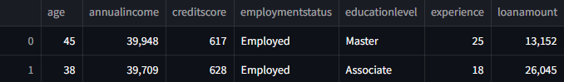
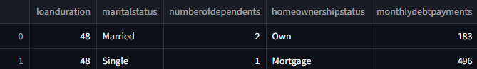
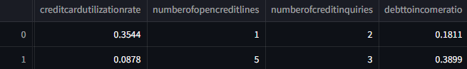
Data Overview :
- Data with shape (20000, 36)

Slide 9

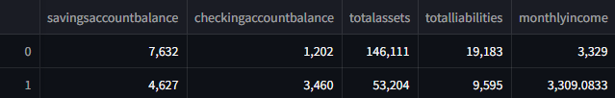
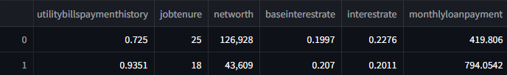
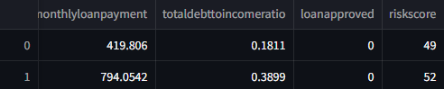

Slide 10
04
EDA & Insights

Slide 11
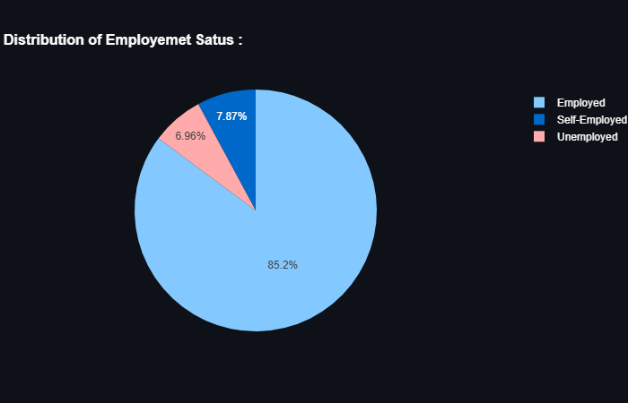
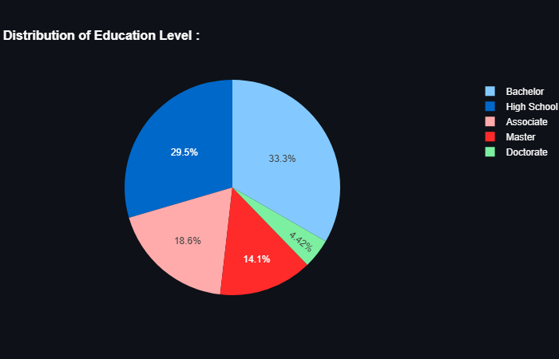
Categorical Columns :

Slide 12
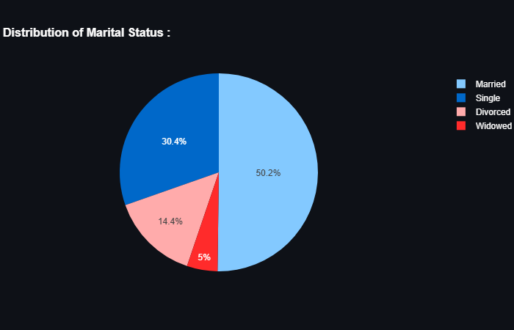
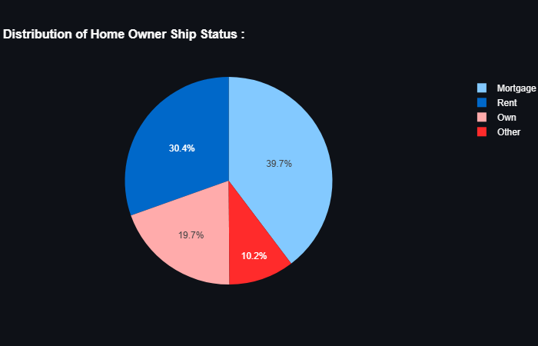

Slide 13
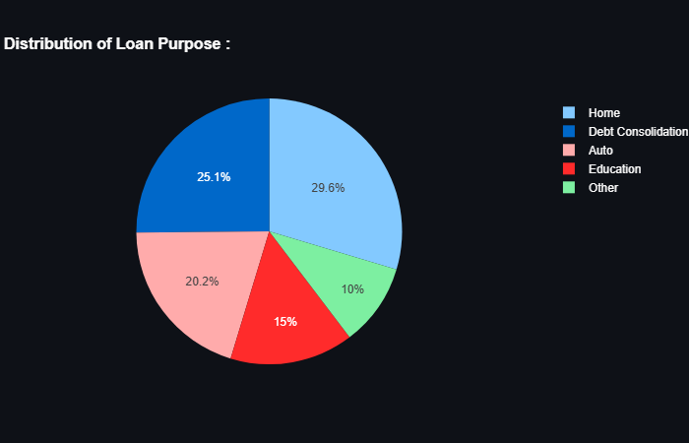
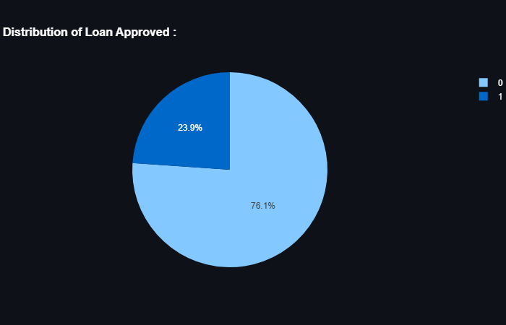

Slide 14
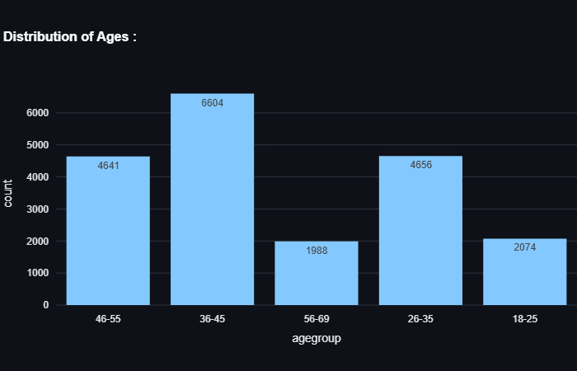
Most of customers with ages 36 – 45.
And ,least of them with ages 56 – 69.

Slide 15
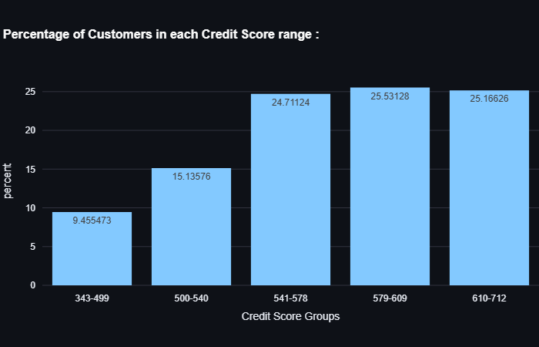
Highest percentage of customers are in 579-609 credit score rang.
Lowest percentage of customers are in 343-499 credit score range.

Slide 16
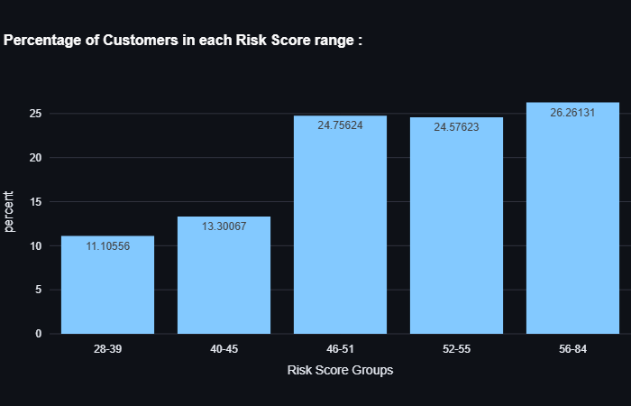
Highest percentage of customers are in 56-84 risk score rang.
Lowest percentage of customers are in 28-39 risk score range.

Slide 17
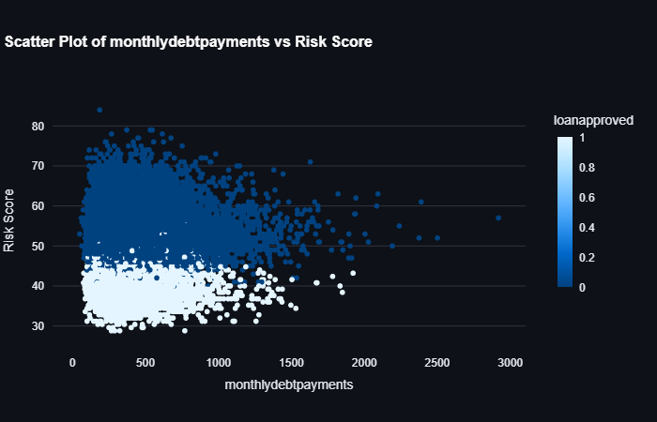
Lower Risk score
&
lower monthly dept
Then, the probability of loan approval increase.

Slide 18
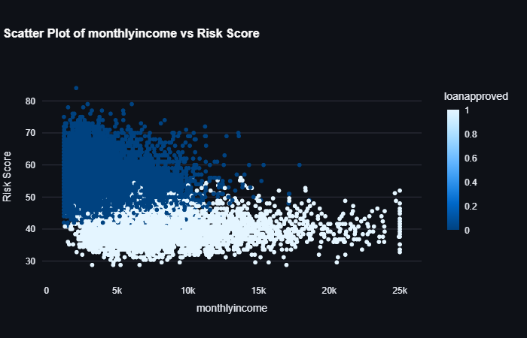
Lower Risk score &
high monthly income
Then, the probability of loan approval increase.

Slide 19
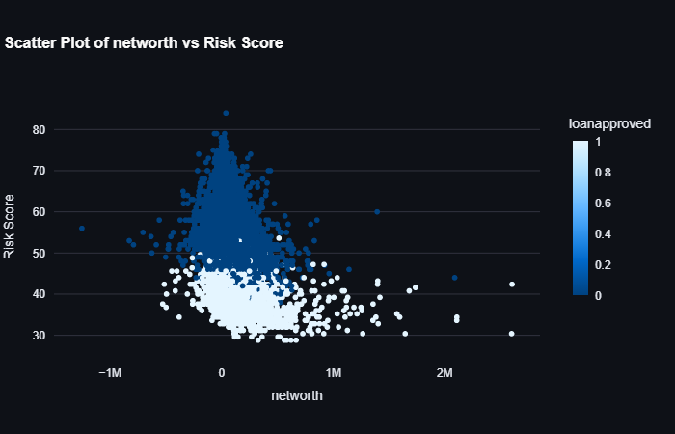
Most of loan approvals have positive, medium net worth and low risk score.

Slide 20
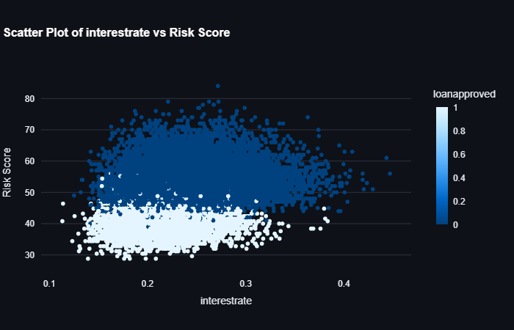
Most of loan approval with
interest rate = 0.15 - 0.3 &
risk score = 30 - 44.
(lower interest rate
&
lower risk score).

Slide 21
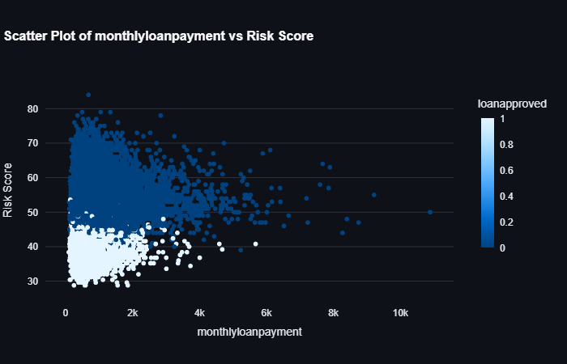
Most of loan approvals with lower monthly loan payment and lower risk score.

Slide 22
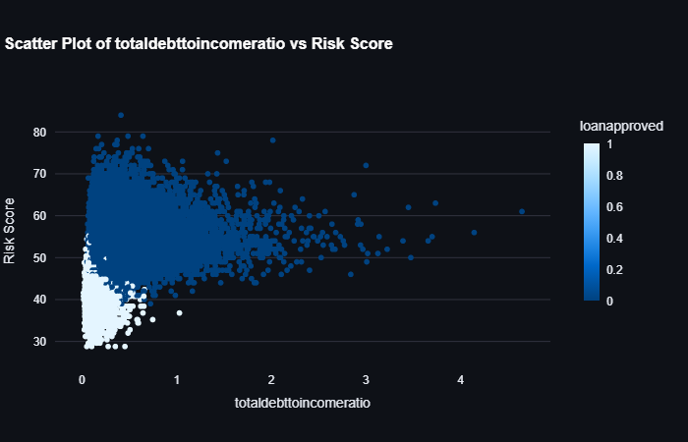
Most of loan approval with total dept income ratio up to 0.4 and risk score up to 45.

Slide 23
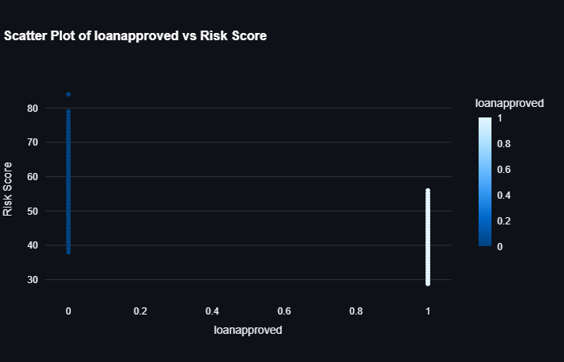
Most of loan approval with lower risk score unlike denied loans.

Slide 24
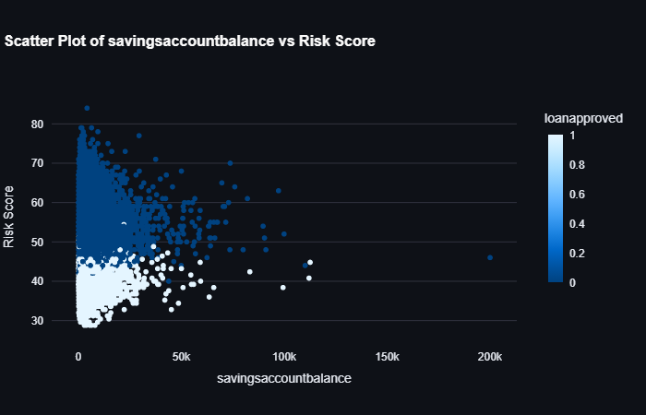
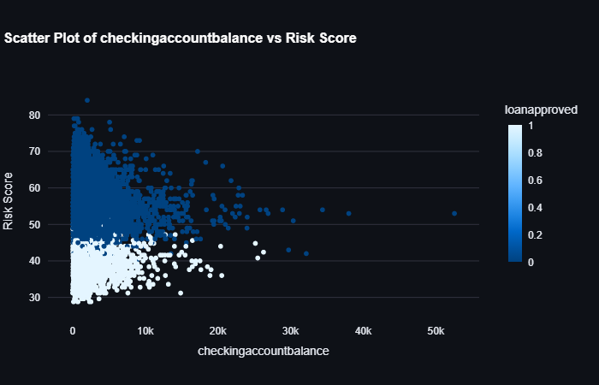
All ranges of saving account balance & checking account balance are with loans approved until being in low risk score.

Slide 25
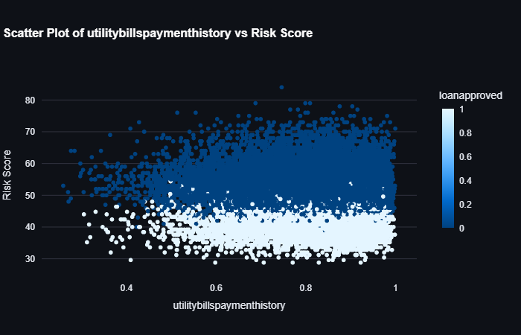
Most of loan approval are with lower risk score and higher utility bills payment history.

Slide 26
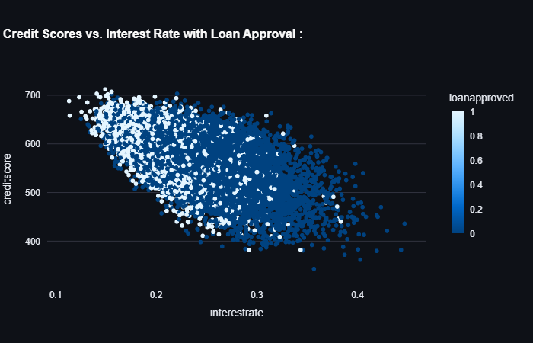
while credit scores decrease & interest rate increase. So, probability of loans denied increase.

Slide 27
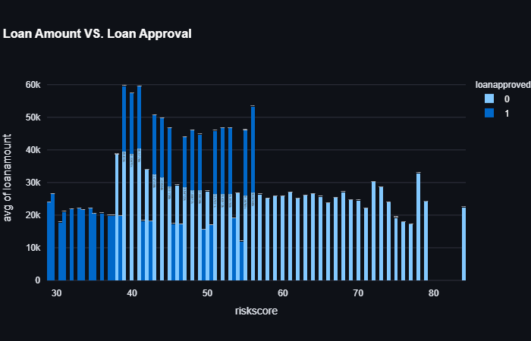
Most of loans with highest average loan amount and high risk score are denied.

Slide 28
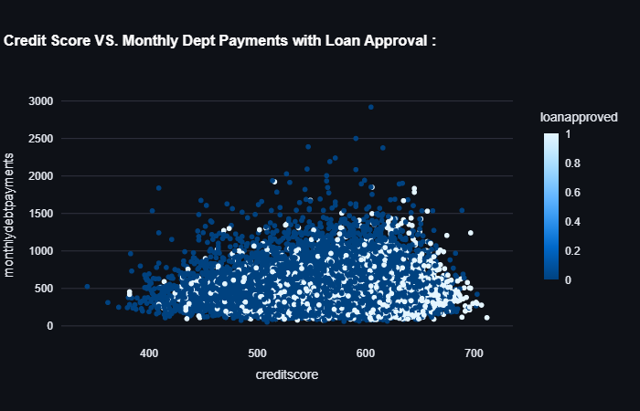
Most of loans exist in lower monthly dept payment. And high credit scores lead to increase chance for loans being approved.

Slide 29
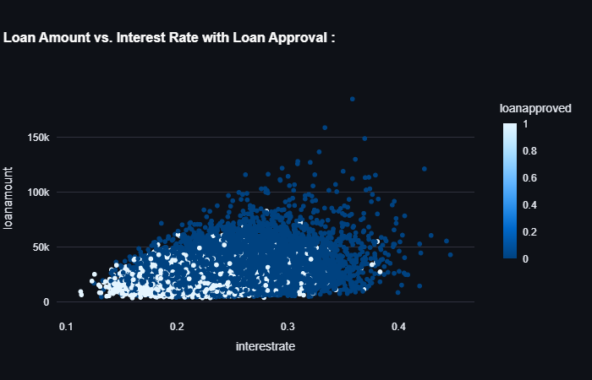
Loans being approved with lower loan amount and lower interest rate.

Slide 30

While monthly dept decrease & risk score decrease. so, chance for loans approval increase.

Slide 31
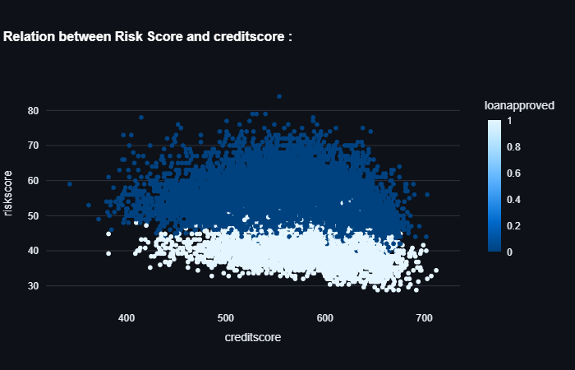
most of loans being approve with high credit score and low risk score.

Slide 32
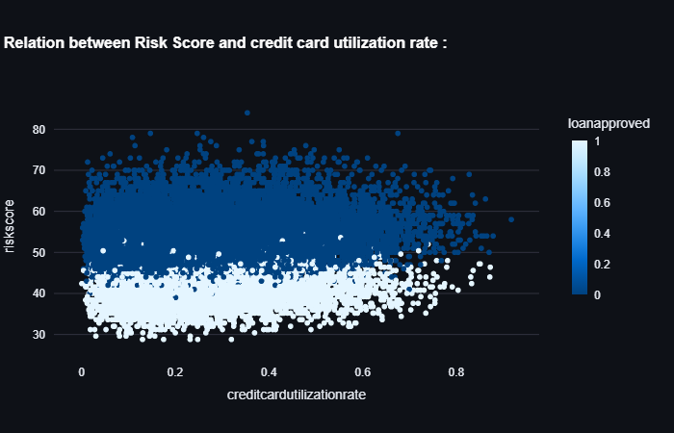
Most of loans approved are with low creditcardutilizationrate and while creditcardutilizationrate increase loans decrease.

Slide 33
05
Data Pre-processing

Slide 34
1. Data doesn’t contain missing values.
2. Used OneHotEncoder for categorical columns as they all are nominal.
3. Applied Log Transformation on continuous numeric columns with skewness.
4. Applied StandardScaler() on data to handle outliers.
5. Applied SMOTE to balance the data by oversampling the minority class (loan approvals).

Slide 35
06
ML Pipeline & Evaluation

Slide 36
Trained models directly within the pipeline to ensure preprocessing steps were applied to data.
Used cross-validation to evaluate models and avoid data leakage.
Applied Models for loans approval prediction :
Logistic Regression.
2. KNeighborsClassifier.
GaussianNB.
SVC.
DecisionTreeClassifier.
RandomForestClassifier.
XGBClassifier.
GradientBoostingClassifier.
AdaBoostClassifier.

Slide 37
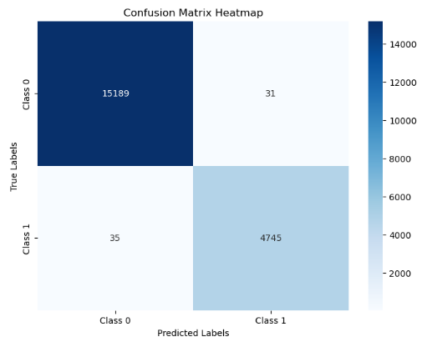
Top 3 high f1- score and precision for first trial :
1. XGB
Train F1-Score = 1.0
Test F1-Score = 0.992
Train Percision = 1.0
Test Percision = 0.993

Slide 38
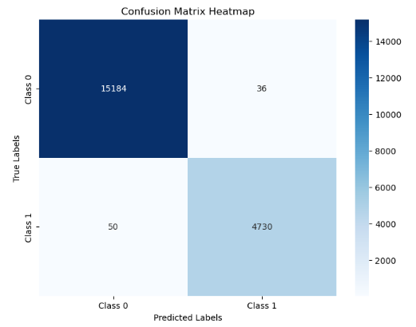
Top 3 high f1- score and precision for first trial :
2. SVC
Train F1-Score = 0.998
Test F1-Score = 0.991
Train Percision = 0.998
Test Percision = 0.993

Slide 39
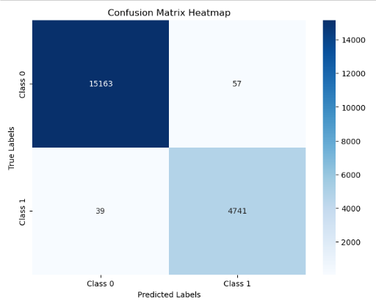
Top 3 high f1- score and precision for first trial :
3. LR
Train F1-Score = 0.991
Test F1-Score = 0.990
Train Percision = 0.990
Test Percision = 0.989

Slide 40
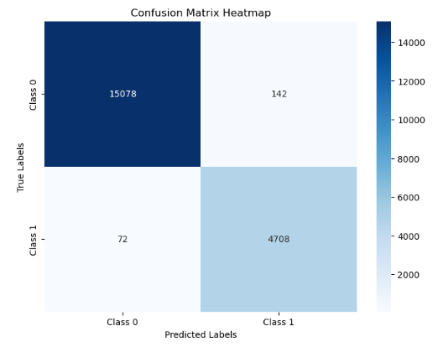
Top 3 high f1- score and precision after appling feature selection :
1. XGB
Train F1-Score = 0.999
Test F1-Score = 0.977
Train Percision = 0.999
Test Percision = 0.969

Slide 41
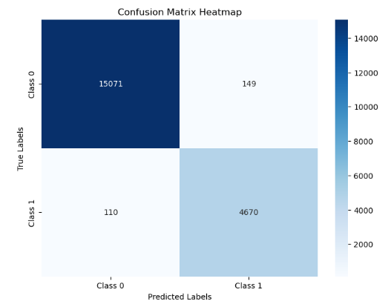
Top 3 high f1- score and precision after appling feature selection :
2. RF
Train F1-Score = 1.0
Test F1-Score = 0.97
Train Percision = 1.0
Test Percision = 0.97

Slide 42
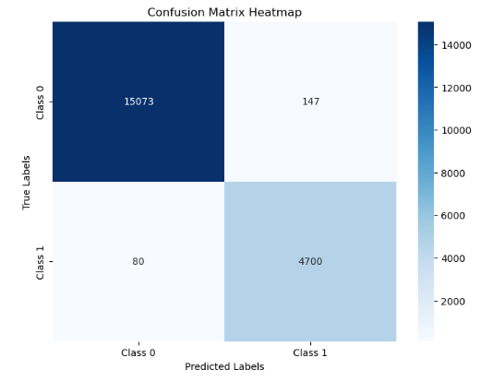
Top 3 high f1- score and precision after appling feature selection :
3. GB
Train F1-Score = 0.98
Test F1-Score = 0.97
Train Percision = 0.97
Test Percision = 0.96

Slide 43
Third Trial :
Applied PCA on data through pipeline but f1-score and precision decrease.
Fourth Trial :
Applied PCA and feature selection on data through pipeline but f1-score and precision decrease.

Slide 44
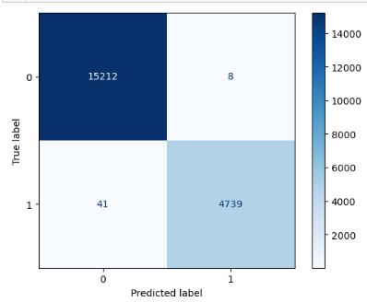
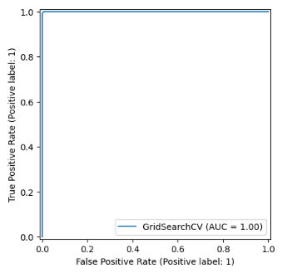
Fine Tuning for Hyperparameters :
1. DT
Max_depth: none , min_sample_leaf : 2 , min_sample_split : 2

Slide 45
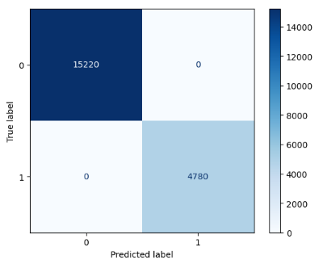
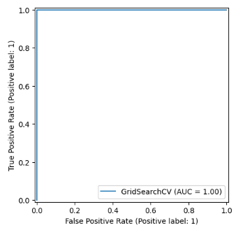
Fine Tuning for Hyperparameters :
2. RF
Max_depth: none , n_estimators : 200

Slide 46
Fine Tuning for Hyperparameters :
3.XGB
Learning_rate : 0.1 , n_estimator : 200

Slide 47
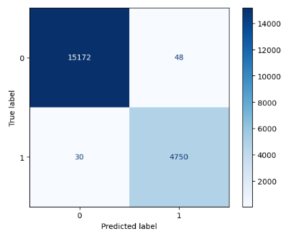
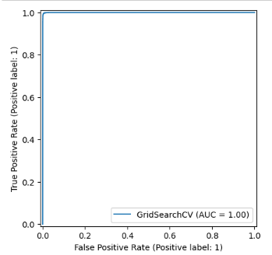
Fine Tuning for Hyperparameters :
4. GB
Learning_rate : 0.1 , n_estimator : 200

Slide 48
The Best are : RandomForest & XGBoost

Slide 49
07
Business Application

Slide 50
Integrating the Model : The model can be integrated into the loan approval system to automate decision-making. Benefits : It evaluates customers based on their financial indicators (e.g., credit score, income, liabilities) and assigns approval probability. Results can be used to flag high-risk customers. Early detection of potential defaulters enables banks to set stricter conditions or require additional documentation.

Slide 51
08
Challenges

Slide 52
Data Preprocessing Issues : - Handling errors and unreal data. - Dealing with skewness and outliers. - Encoding process. Imbalanced Dataset : - Loan approval data has fewer approved loans compared to rejected. - Addressing this imbalance with techniques like SMOTE required parameter tuning to avoid overfitting. Model Training Challenges: - Achieving a balance between F1-Score, percision and recall for high-risk customers was complex. - Computational resources were a constraint when tuning advanced models like XGBoost. Scale and Diversity

Slide 53
09
Conclusion

Slide 54
Problem :
- The project focused on predicting loan approval based on financial risk indicators, addressing challenges like high default rates and imbalanced dataset.
Approach :
- implemented a robust pipeline involving data preprocessing, SMOTE for balancing, feature engineering, and training machine learning modelsز
Results :
-The models achieved strong performance metrics, with high F1-Score, precision and recall, effectively identifying risky customers.

Slide 55
Thank You

